Slide 1
Spider Task 2

Slide 2
Parts included in the Circuit
Input Pulse Signals
Address Generators of the input signals at DIN
ADC
Serial In Parallel Out Shift Register at DOUT
12 bit Comparator
Demultiplexer
High Duty cycle PWM generator
Low Duty cycle PWM generator
Mux to select PWM
Motor Driver
Motors

Slide 3
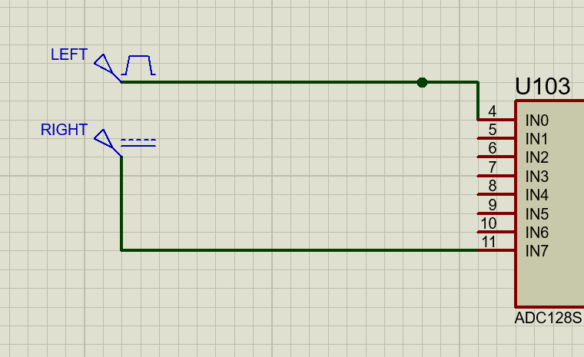
Input Pulse Signals
I have given pulse signal for one of the sensor’s output and a DC signal for another sensor’s output. We are assuming there’s a left turn for now to demonstrate. I have given time period as 10 seconds with 90% pulse width to read a left turn. I have connected the sensors to Channel 0 and Channel 7 for easier selection in DIN.
i

Slide 4
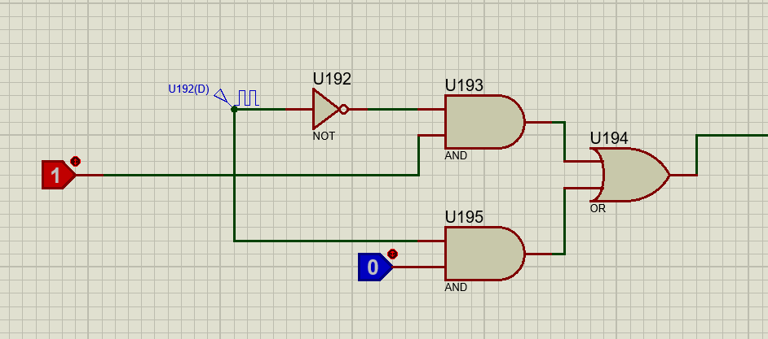
Address Generator for DIN
This is a multiplexer which has inputs as addresses of channels(Channel 0 and Channel 1) we are using . Address of channel 0 is XX000XXX. Address of Channel 1 is XX111XXX. So , I am just using 00000000 and 11111111 as addresses. It will change between addresses of channel 1 and channel 0 every 32 clock cycles because after the first 16 clock Cycles ,Chip select will be high for another 16 cycles.
We can also use a simple clock cycle for generating this address.

Slide 5
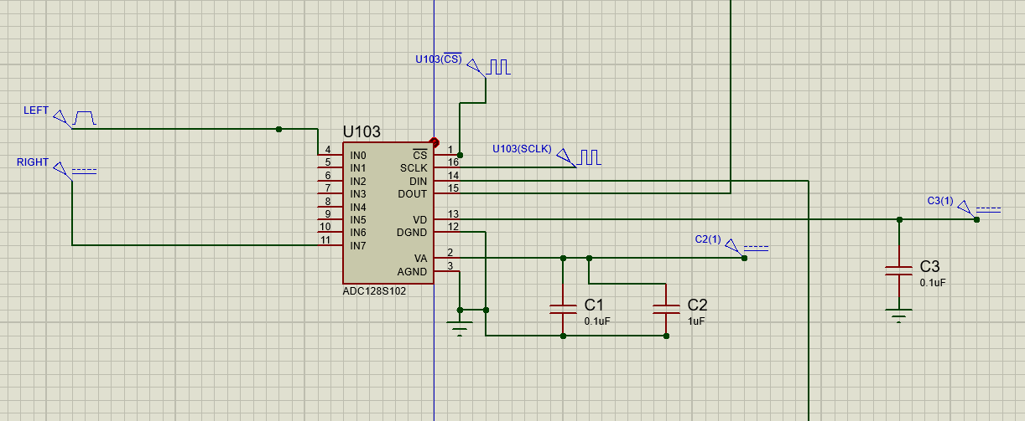
Analog to Digital Convertor
ADC converts the analog inputs to digital inputs for easier working. We get 12 bit digital output from this ADC in a serial manner which needs to be converted to parallel form.
System clock is set to 8 MegaHertz .
As 16 clock cycles of system clock needs to be in one Low of CS , we have selected the frequency of CS as 0.25 MegaHertz.
AGND and DGND are connected to ground.
VA is connected to 3.3 Voltage as it is the reference Voltage.
Vd is also connected to 3.3V as it is mentioned to connect between 2.7-3.3V

Slide 6
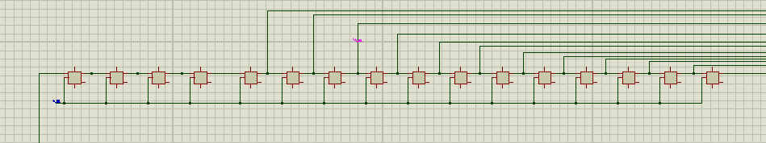
Serial in Parallel Out Shift Register
A serial Digital Value of the analog input comes out of the dout.
For the first 4 cycles of the 16 clock cycles , dout gives 0000 whatever the input. Digital value comes for the next 12 clock cycles.
So we are extracting 12bits from the last 12 flip flops and we will feed these to comparator.

Slide 7
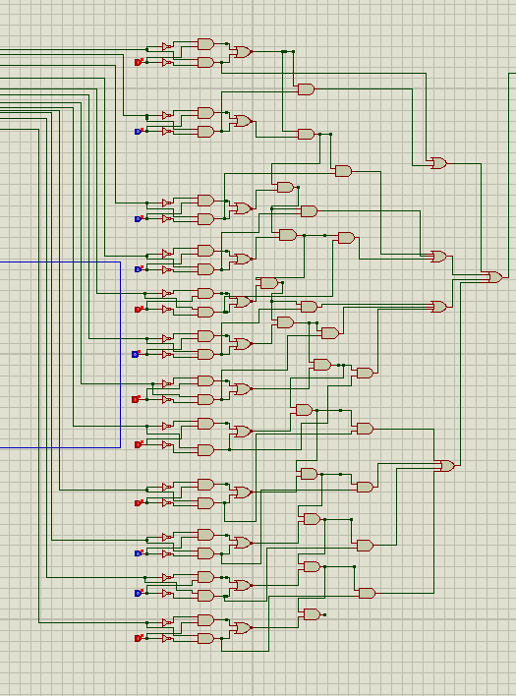
12 Bit Comparator
We have set 1.8 voltage as the threshold voltage to segregate white and black.
Whatever value we get is separated to high or low by comparing with comparator.
The value of 1.8 Voltage in digital 12 bit is 100010111001(3.3V is 111111111111).
If the value from dout is higher than 1.8V , output is high from comparator and if it is lower than 1.8V, output is low from comparator.

Slide 8
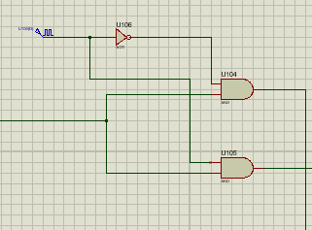
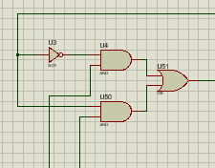
Demux and Mux
We are separating the values of left sensor and right sensor using a demux as they are varied in a serial manner. Selector pin of the demux is given same clock signal as selector pin mux in din. So that the value of left sensor goes to left motor and value of right sensor goes to right motor.
The separated values are then fed into selector pins of 2 multiplexers , where the inputs of the multiplexers are high duty cycle PWM and Low duty cycle PWM.

Slide 9
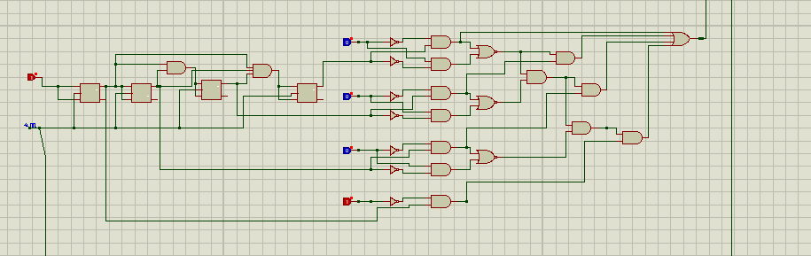
High duty cycle PWM generator
High Duty cycle PWM is used for fast rotation of motor. When selector pin gets value 1 , This PWM will give high value output for faster rotation. This is connected to enable pins of Motor Driver after going through the multiplexer to control the speed.

Slide 10
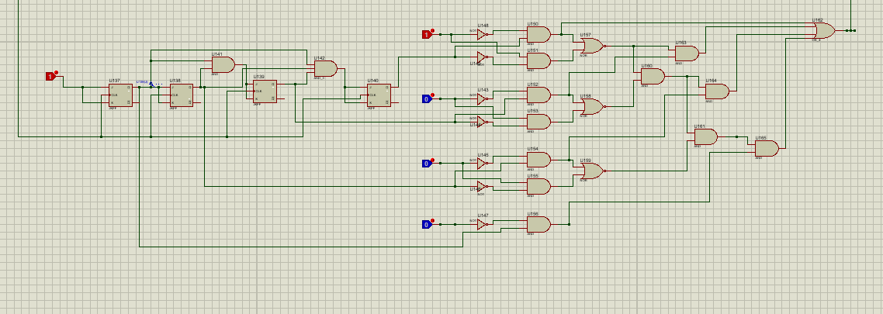
Low duty cycle PWM generator
Low Duty cycle PWM is used for slow rotation of motor. When selector pin gets value 0 , This PWM will give low value output for slower rotation. This is connected to enable pins of Motor Driver after going through the multiplexer to control the speed.

Slide 11
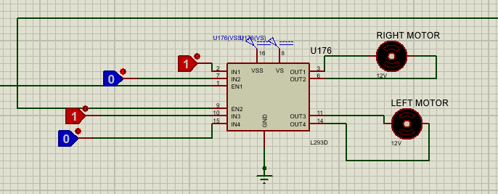
Motor Driver
In1 and In2(For Right motor), In3 and In4(For Left Motor) needs to be given 1 and 0 respectively for clockwise direction.
Enable pins are where PWM signals where speed of the motor is controlled. EN1 is for right and EN2 is for left motor.
GND is connected to ground
VSS voltage is given 5V.
VS voltage is given 12V which is the nominal voltage of dc motor.
Out1 is for Right motor and Out2 is for Left motor.

Slide 12
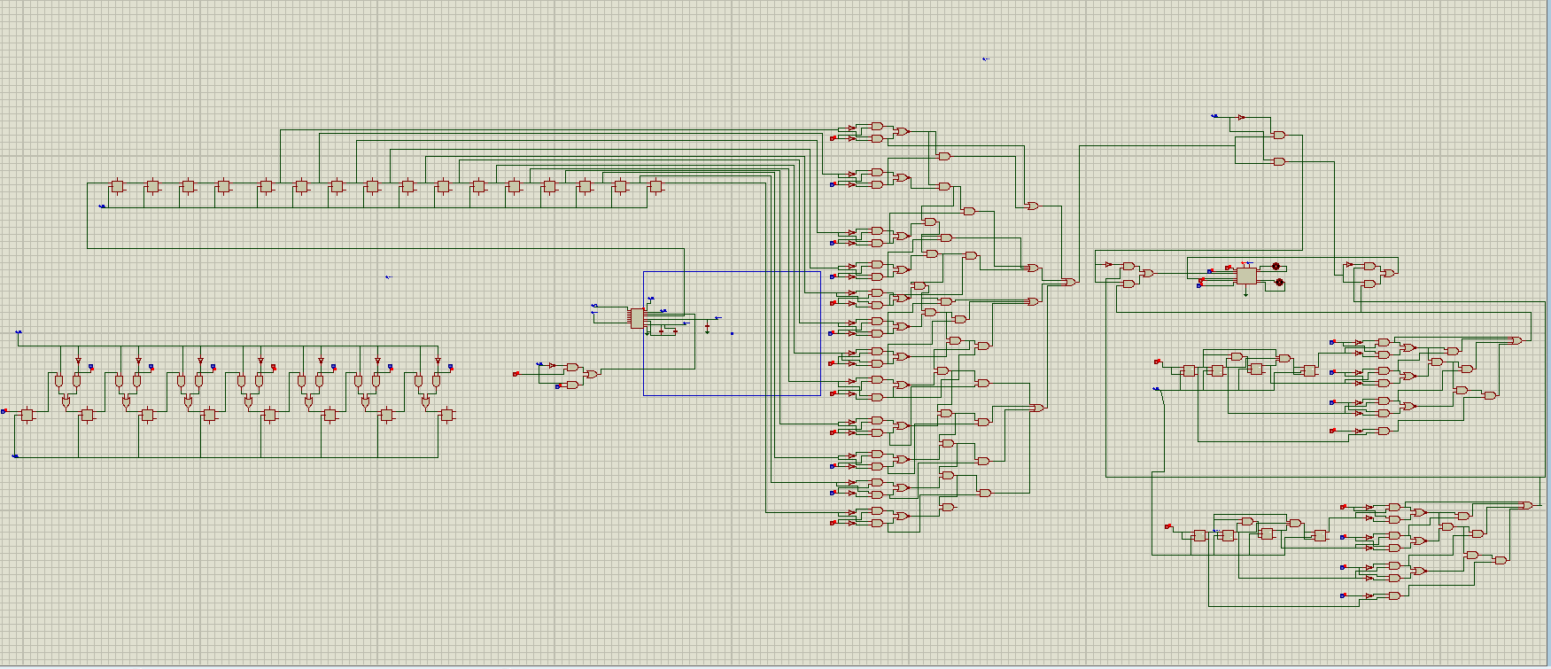
Whole CIrcuit

